Slide 1
Intramural Sports League Manager
By Sargune Kalsi and Tanner Nodolf

Slide 2
System Description
Our project is a basic intramural sports system
Users can sign up for teams that play different sports, the teams play refereed games, which then goes into a record
Each user has info associated with them, team has users and so-forth
Sign up page for users
Main page that displays games/teams
Page to update scores

Slide 3
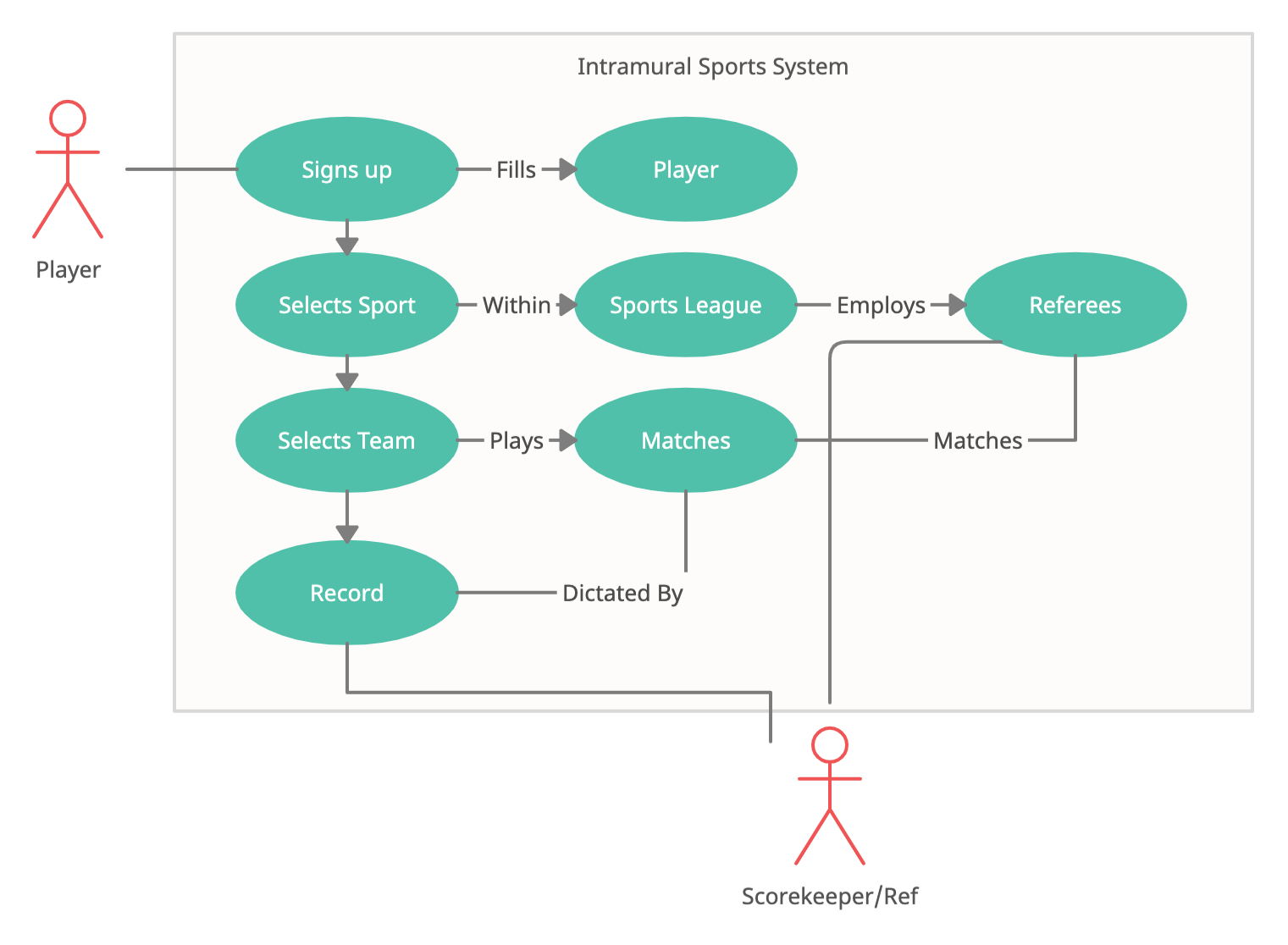
Use Case:

Slide 4
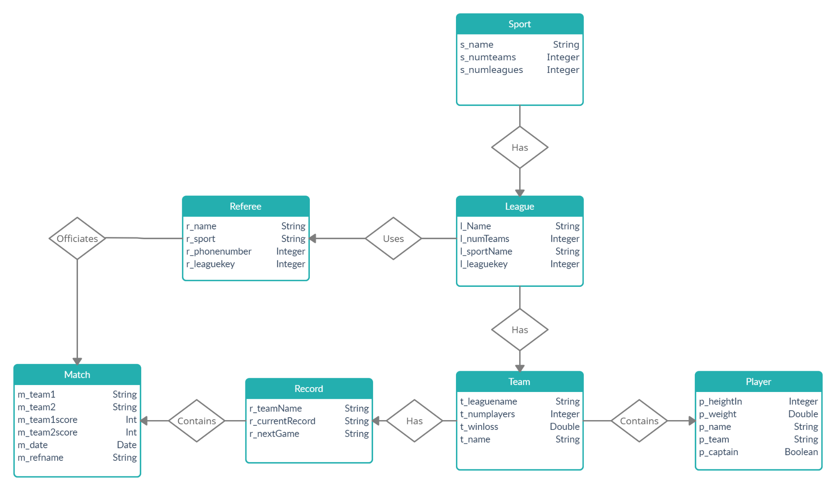
E/R Diagram

Slide 5
Implementation Details
We used Flask.py as a framework for our web app, with SQLite3 for our database
Front-end development will be done in HTML/CSS and JS
Haven’t decided on a JavaScript SDK yet
Possibly using PHP if solutions can’t be found with Python

